Slide 1

Using NSLDS Updated July 2012
Dana Kelly, Regional Director and Trainer
Nelnet Partner Solutions

Slide 2

Agenda
Accessing National Student Loan Data System (NSLDS)
Transfer Monitoring overview
Pell Grant Lifetime Eligibility Used (LEU)
Aggregate questions
Report changes
Exit counseling

Slide 3
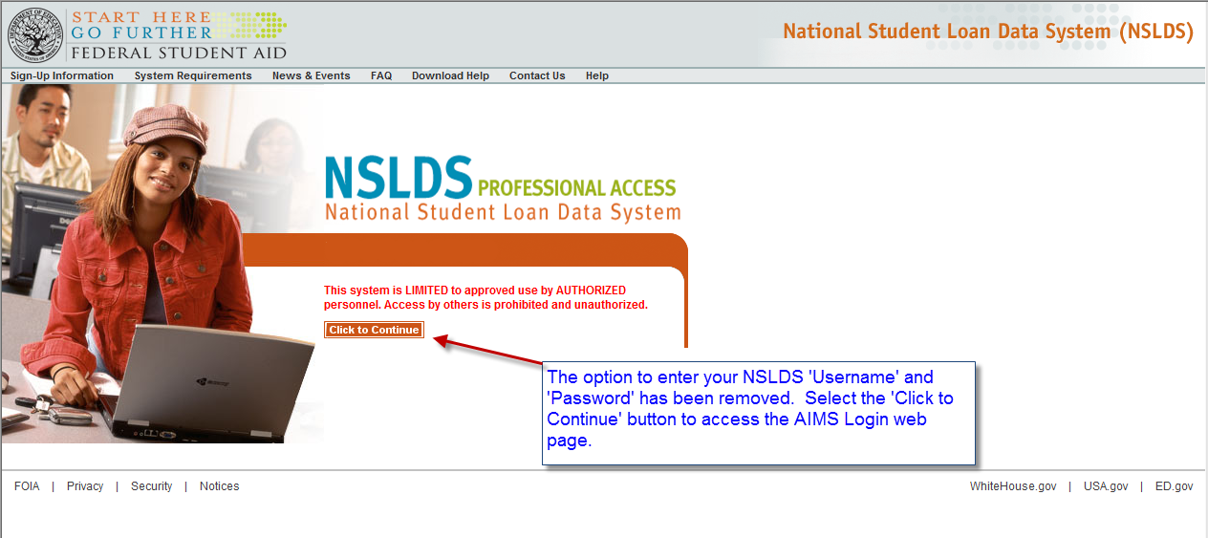
NSLDS Access and Security
NSLDS Access -Now behind Access and Identity Management System (AIMS)

Slide 4
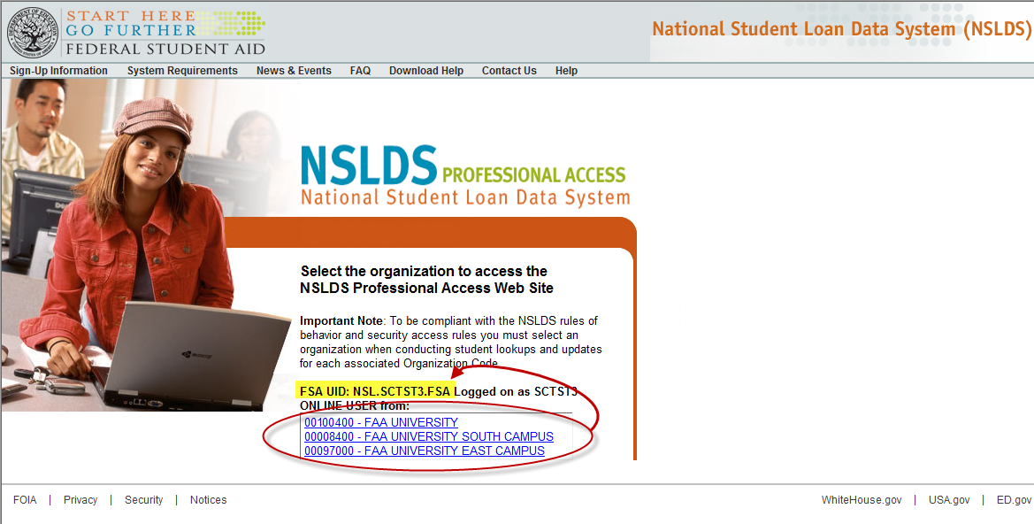
NSLDS Behind AIMS

Slide 5
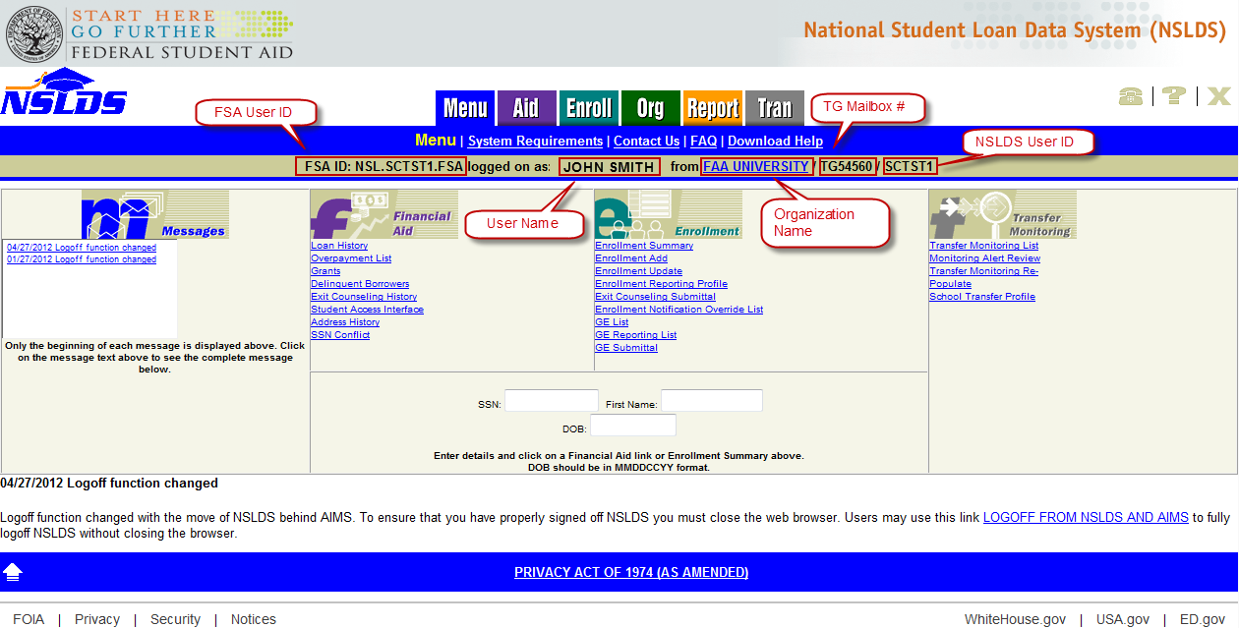
NSLDS Behind AIMS

Slide 6
Transfer Monitoring Review

Slide 7
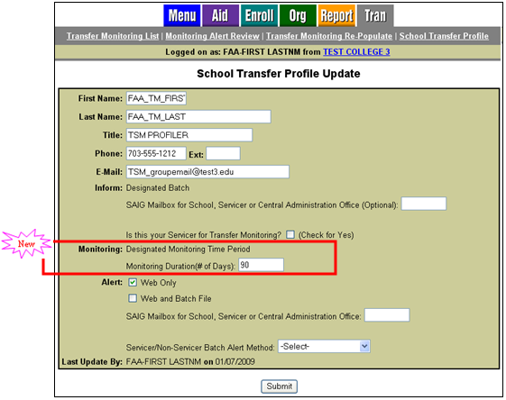

Transfer Student Monitoring
Alert process enhanced Customize monitoring duration
Notes:
Customize monitoring duration to fit your school’s business processes
7

Slide 8
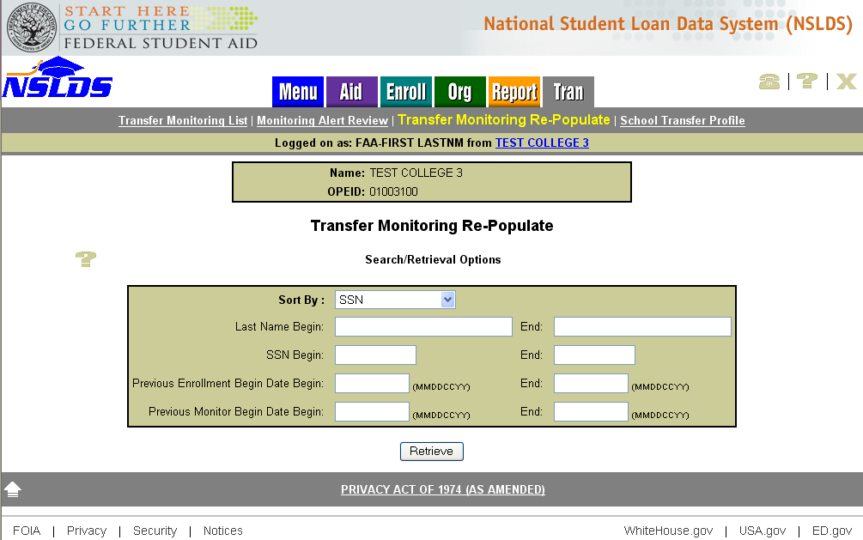
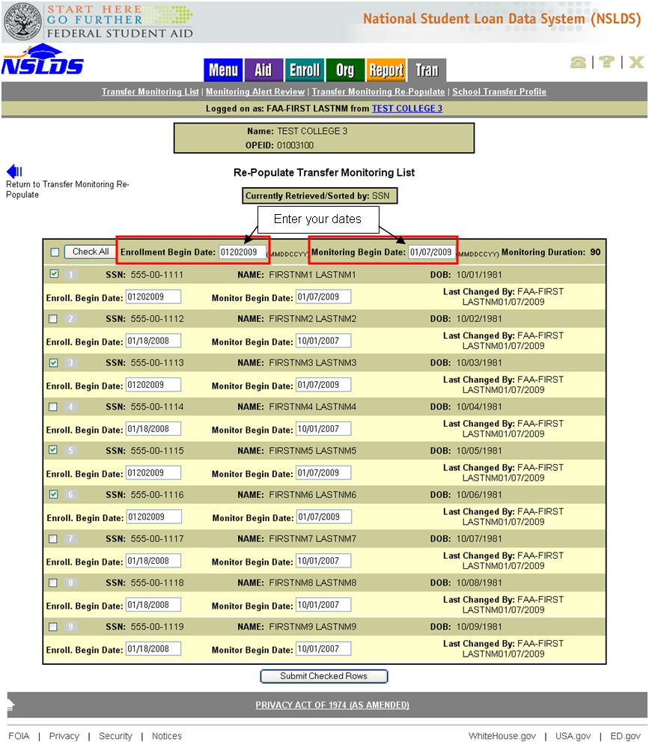
Transfer Student Monitoring
Re-populate list using previous records
Select criteria to retrieve previous records
Enter new dates
Select records to add to new monitoring list
Notes:
8

Slide 9
Pell Grant Lifetime Eligibility Used

Slide 10

Pell Grant LEU
  Total received ≤ 6 years
  Maximum each year = 100%
  6-year equivalent = 600%
Notes:
The amount of Federal Pell Grant funds a student may receive is limited to the equivalent of six years of Pell Grant funding
Since the maximum amount of Pell Grant funding a student can receive each year is equal to 100%, the six-year equivalent is 600%

Slide 11
Pell Grant LEU
Calculated by Common Origination and Disbursement (COD) system and provided to NSLDS
One time “catch up” file provided in July from COD for award year 1973-74 and forward
All subsequent changes will be sent to NSLDS by COD

Slide 12
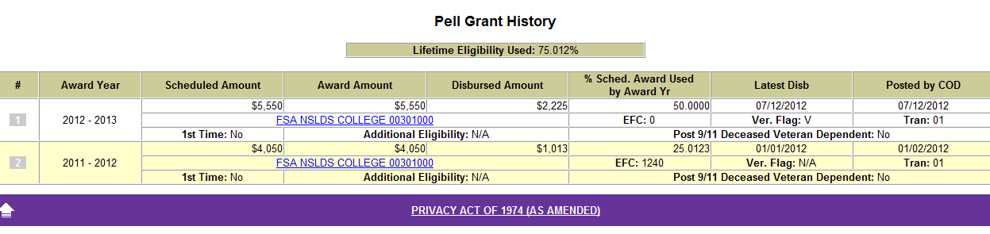
Pell Grant LEU
Website locations
  NSLDS Professional Access, Grant page
  NSLDS Student Access, Grant section

Slide 13

Pell Grant LEU
NSLDS to Central Processing System (CPS)
New Pell LEU flag in pre-screening match:
    E = Limit ≥ 600%
    C = Close to limit (between 501% and 599%)
    H = High % warning (between 451% and 500%)
    N = No problem
Began July 2012, Award Year 2012-13

Slide 14
Pell Grant LEU
  If Pell LEU flag = E or C
  Student Aid Report (SAR) C flag is set
  SAR comments generated to help with resolution
  Began July 2012, Award Year 2012-13

Slide 15
Pell Grant LEU
NSLDS to CPS
New post-screening reason codes:
      20 = Pell eligible & ≥ Pell LEU limit (600%)
      21 = No longer ≥ Pell LEU limit
      22 = Pell eligible & close to Pell LEU limit (501 to 599%)
      23 = No longer close to Pell LEU limit
Began July 2012, Award Year 2012-13

Slide 16
NSLDS Aggregate Questions and Reaffirmation

Slide 17
What is Reaffirmation?
The Department sets annual and aggregate Stafford loan limits that a student cannot exceed, but sometimes students are overawarded. The student cannot received any more federal aid until this overage is addressed. One of the ways to resolve this issue is called “reaffirmation.”

Slide 18
Why is Reaffirmation Important?
Every student loan originated is covered by a Master Promissory Note. This constitutes a legally binding contract that requires the borrower to repay the loan in regards to the requirements listed. The “Promise to Pay” section only covers the funds the student was eligible to receive, however.

Slide 19
Resolving Overawards
Satisfactory Repayment Arrangement
  borrower signs a promise to pay for the overage amount
    borrower signs and returns a reaffirmation letter
    borrower consolidates his/her loans
Reallocation of loan balance
  can only resolve a Subsidized overage or an annual overage
  will not work if the student exceeds his/her total loan limit
  Only the school that certified the loan(s) in question can request a reallocation
Pay down the overage
  borrower would have to pay enough of the loan balance to reduce the principal by the overage amount
  could potentially include interest, and require a payment much greater than the overage itself to pay the loan down

Slide 20
NSLDS and Aggregate Balance Calculation
Aggregate Outstanding Principal Balance (Agg OPB) is an auto system calculated field on NSLDS that is used to total up loan balances for annual and aggregate amounts
  Original Disbursed Amount
  Outstanding Principal Balance

Slide 21
Calculating the Agg OPB
The loan is originated and Agg OPB starts at the Original Disbursed Amount
If the student pays the Outstanding Principal Balance (OPB) below the Original Disbursed Amount the Agg OPB reduces to the OPB.
If interest capitalizes, the Agg OPB will increase but will NEVER go above the Original Disbursed Amount.
    NOTE: it is possible for a student to pay down an overage, and have it reappear as soon as interest capitalizes again

Slide 22
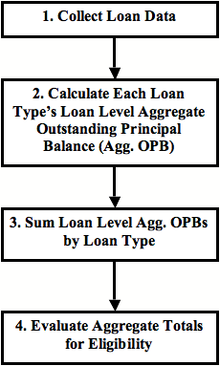
NSLDS Aggregate Calculation Process

Slide 23
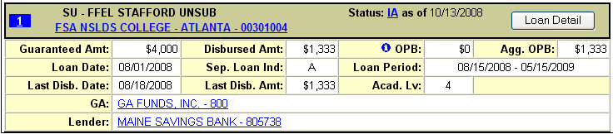
Components of Recent Loans
Pending Disbursement Amount = Net Loan Amount – Disbursement Amount
Loan Summary
Loan Status (“in school”)
Greater of: Disbursement Amount or OPB
Loan Period End Date + 90 Days has not passed

Slide 24
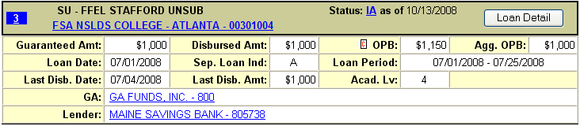
Components of Older Loans
Loan Summary
Loan Status
Loan Period End Date + 90 days have passed
Lesser of: Disbursement Amount, OPB, or Net Loan Amount

Slide 25
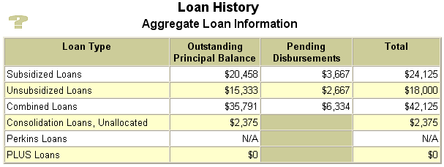
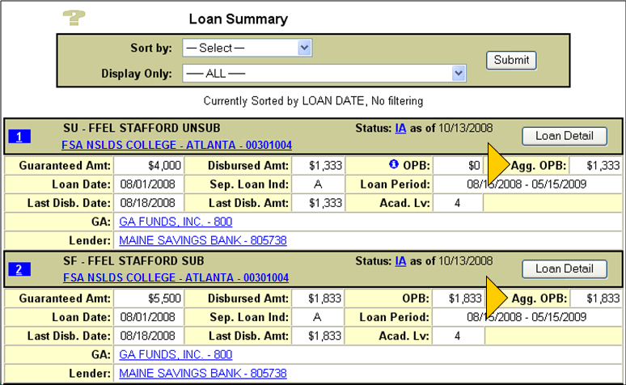
Aggregate OPB

Slide 26
Recent Aggregate Concerns
Capitalized Interest
  Considered, but not counted, when balance is > than total disbursed
  If borrower pays down the loan, NSLDS calculation does not differentiate OPB from the capitalized interest
  School can determine appropriateness of awarding additional loan amount

Slide 27
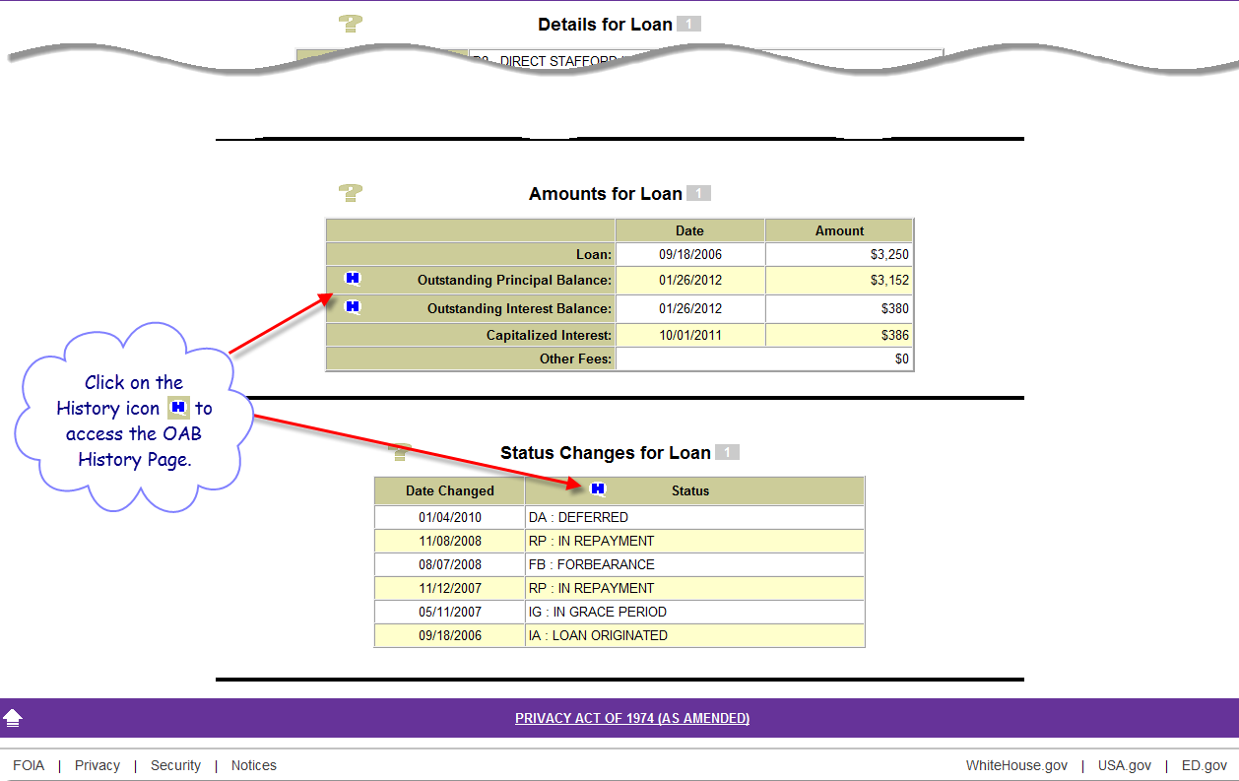
Filtering Option on Loan Detail Page

Slide 28
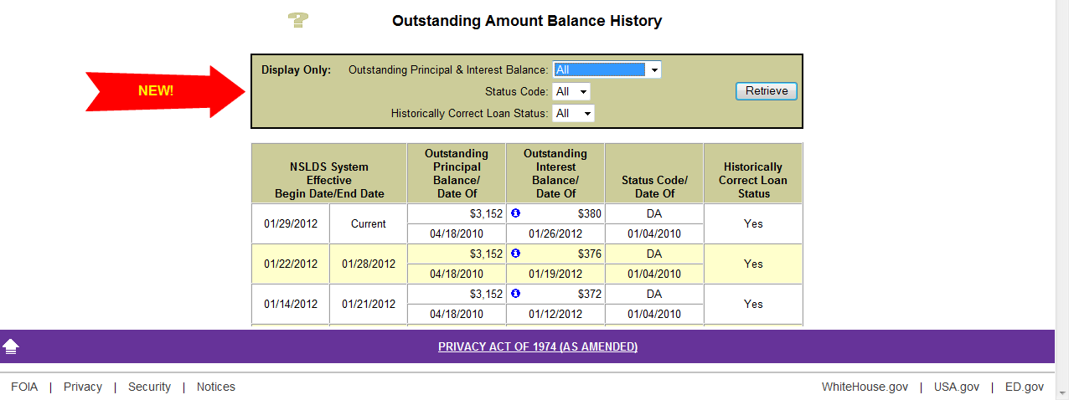
Filtering Option on Loan Detail Page

Slide 29
Recent Aggregate Concerns
D5 Unsubsidized Consolidation Loans
  Included Grad PLUS and Parent PLUS loans causing inaccurate unsubsidized aggregates
  NSLDS adjusted the calculation to exclude loans paid by consolidation underlying Grad PLUS (D3, GB) loans and Parent PLUS (D4, PL) loans
  Post-screening records will indicate the update

Slide 30
Report Changes

Slide 31
School Portfolio Report (SCHPR1)
Provides details on borrowers in your current loan portfolio
Based on loan repayment begin date
Previous school codes included (if school has merged)
Available in extract only

Slide 32
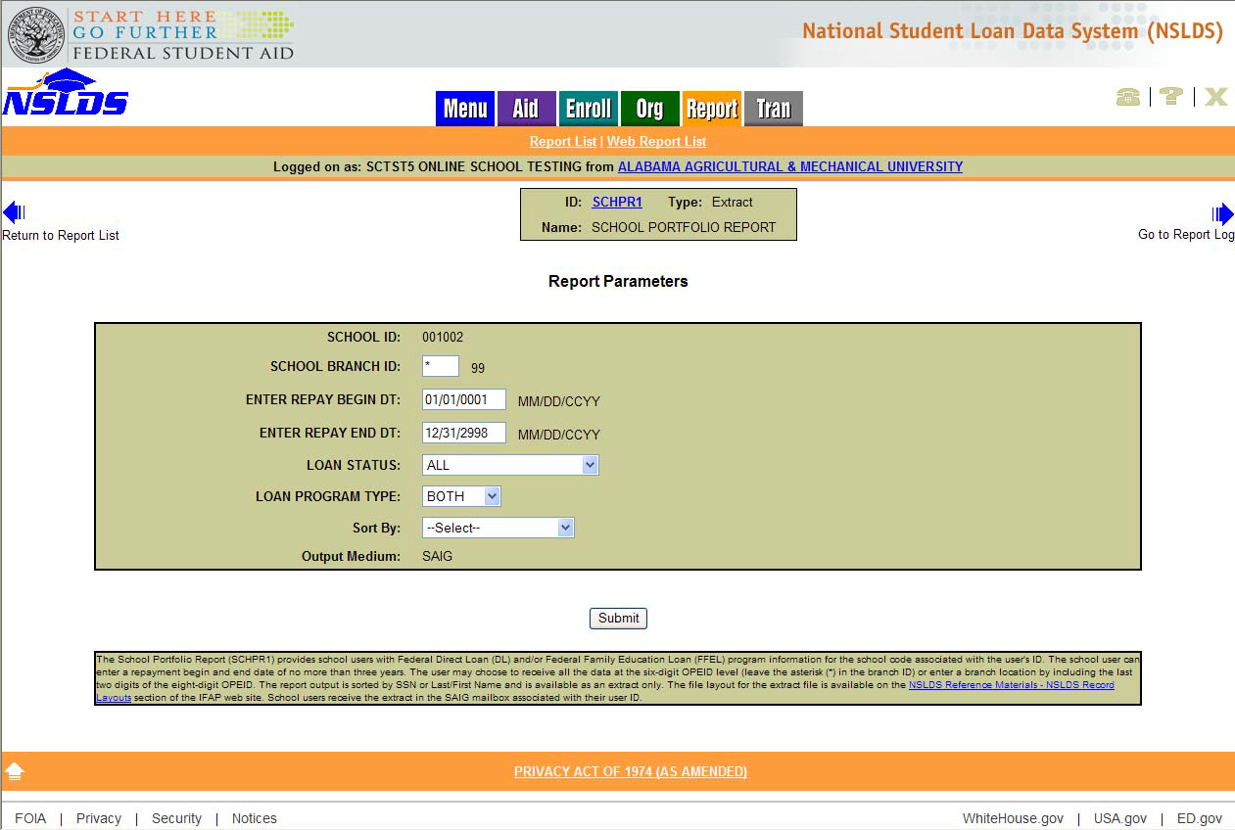
School Portfolio Report (SCHPR1)

Slide 33
School Portfolio Report Uses
May eliminate need for other reports
Can request up to three years of loans that entered or will be entering repayment
Can track student’s loan activity
  Current status
  Current principle and interest balances
  Delinquency date

Slide 34
Requesting a Report
Click on blue number
Complete report parameters
Select Extract or Report (where applicable)
File layouts on IFAP/NSLDS Reference Materials -NSLDS Record Layouts
Delivered to SAIG mailbox

Slide 35
School Portfolio Report
  Addition of consolidation loans
    Consolidation loans added based on the Date Entered Repayment of the underlying loan
  Addition of PLUS borrower identifiers
    Changed student identifier fields to borrower identifier fields. New fields for student identifiers
November 2011 Release

Slide 36
School Portfolio Report
  Addition of repayment plan information
    Current repayment plan code
    Repayment plan date
    Repayment term
    Scheduled payment amount
  Record Layout expanded from 400 bytes to 550 bytes
November 2011 Release

Slide 37
Delinquency Report (DELQ01)
Now includes delinquent borrowers reported by all federal loan servicers
Contains borrowers’ contact information (address, phone number, and e-mail) as it has been reported to NSLDS
Driven off of number of days delinquent

Slide 38
Delinquency Report
Data can change based on when report is run
Days delinquent could be calculated from School Portfolio Report
Use “Delinquent Borrowers” link under Aid tab for current data

Slide 39
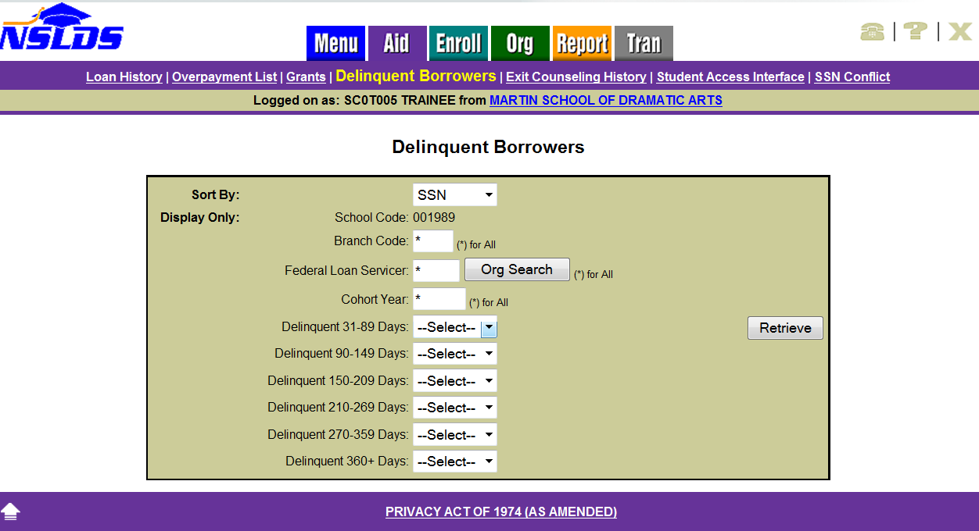
Delinquent Borrowers Web Option

Slide 40
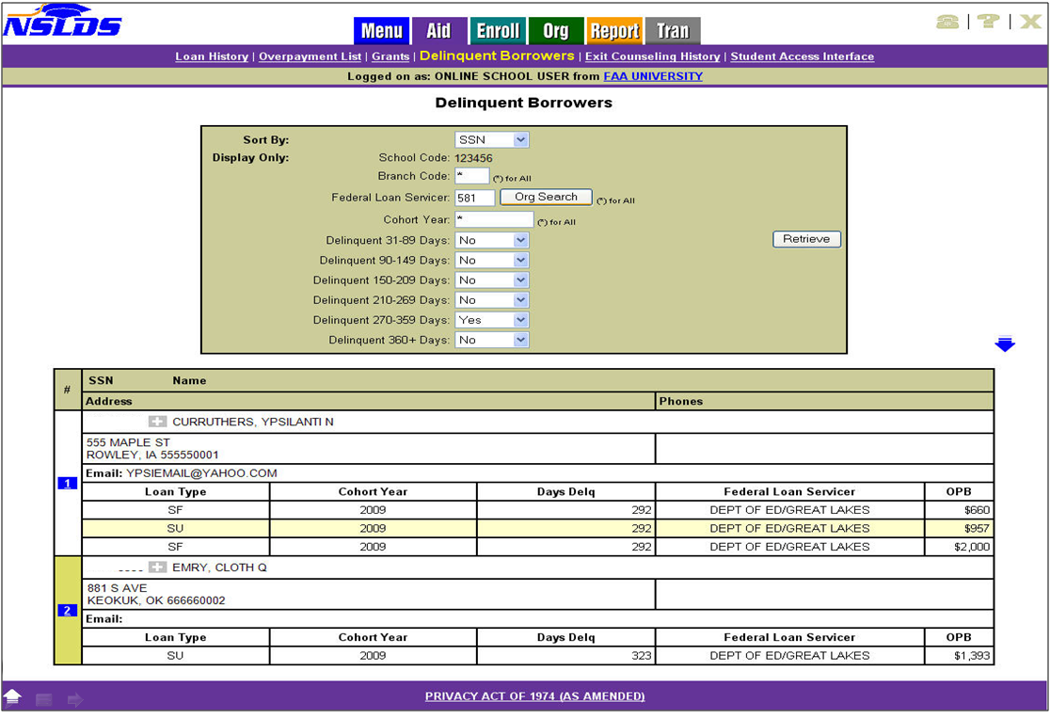
Delinquent Borrower Results

Slide 41
Delinquency Report
  Addition of consolidation loans
    Consolidation loans added based on the School Code of the underlying loan
    Consolidation Indicator
    Consolidation ID
    November 2011 Release

Slide 42
Delinquency Report
  Addition of PLUS borrower identifiers
    Changed student identifier fields to borrower identifier fields. New fields for student identifiers:
      Student SSN
      Student First Name
      Student DOB
    November 2011 Release

Slide 43
Exit Counseling

Slide 44
FSA Exit Counseling
Integrated into www.nslds.ed.gov
      Current student site for aid detail
      Student uses PIN to access
Coordinating with COD to use same terminology as in Entrance Counseling
Student Access website -TEACH Grant Exit Counseling session added

Slide 45
FSA Exit Counseling
NSLDS will provide student with current loan data
Calculators for various repayment types provided
Link provided to loan holder site (where available) to facilitate communication
Available in both English and Spanish

Slide 46
Benefits of FSA Exit Counseling
  NSLDS will be able to upload/store completion records when school uses another product
    Multiple formats will be available for this process
    Allows comprehensive tracking to be included in reports
  FSA Exit Counseling product will change with any compliance or regulatory requirements

Slide 47
Benefits of FSA Exit Counseling
  Introduces students to the NSLDS website
  Uses actual student’s data
  Student completion will be tracked via NSLDS
  School reports will be available
    To review who has completed
    To use for audits
  Evidence of completion will be sent to TIVAS, Direct Loan Servicer, and Guarantors

Slide 48
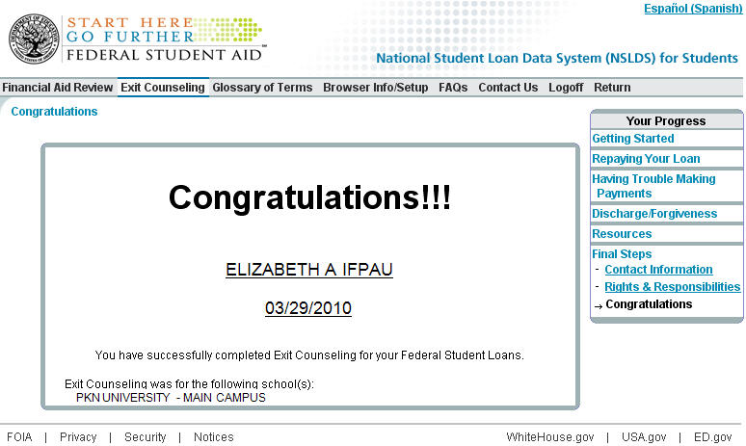
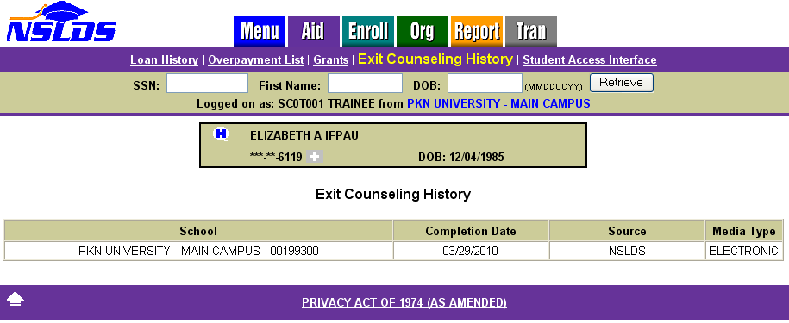
Student completes
Completion viewable on NSLDSFAP

Slide 49
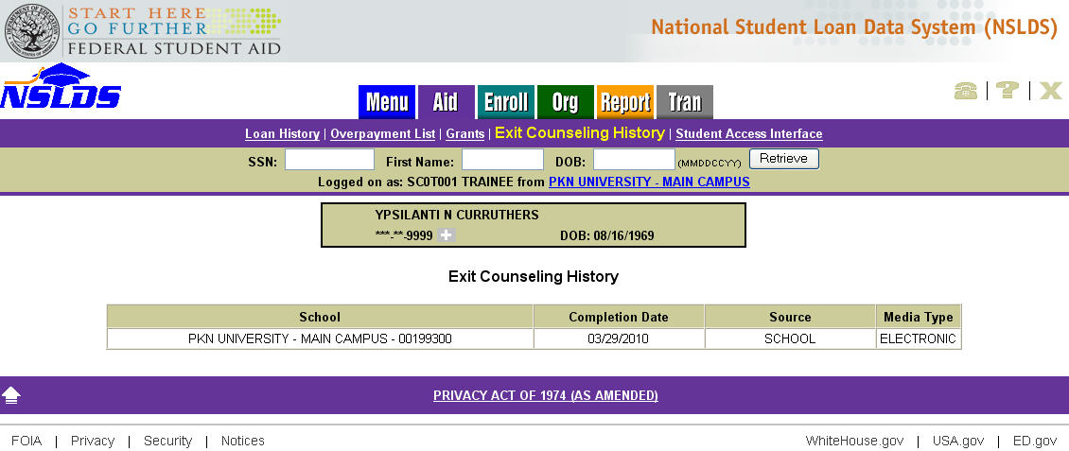
Exit Counseling
Student’s exit counseling completion(s) displayed on NSLDFAP website
Source: NSLDS (Student Site) or School (Upload)
Media Type: Electronic or Paper
Notes:
49

Slide 50
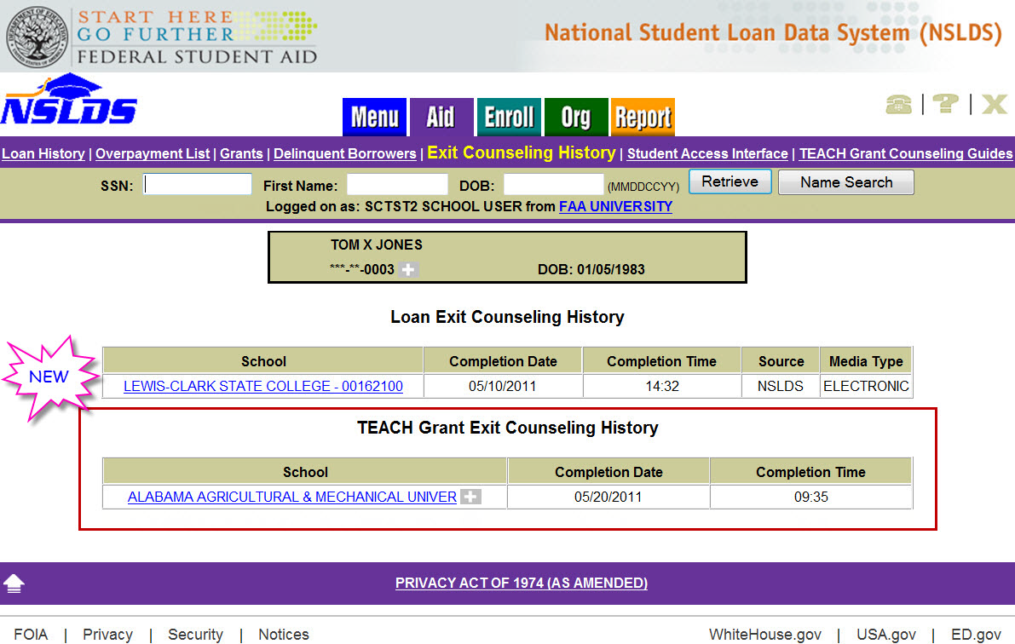
Teach Grant Exit Counseling History

Slide 51
NSLDS Contact Information
Customer Support Center:
Phone: 800-999-8219
Fax: 785-838-2154
Web: www.nsldsfap.ed.gov
Email: nslds@ed.gov
Notes:
51

Slide 52
Nelnet Contact Information
Dana Kelly
336.848.6441
dana.kelly@nelnet.net
School Service Center
866.4NELNET
SSC@nelnet.net

