Slide 1
U.S. Department of Education
2012 Fall Webinar Training Series
Return of Title IV Funds:
Modules

Slide 2
Theory Behind the Calculation
Student earns Title IV aid through attendance
  Percentage of aid earned is equal to the percentage of payment period or enrollment period completed

Slide 3

How Does It Work?
If school has disbursed more aid than the student has earned, money is returned to the programs
If school has disbursed less aid than the student has earned, a post-withdrawal disbursement will be calculated

Slide 4
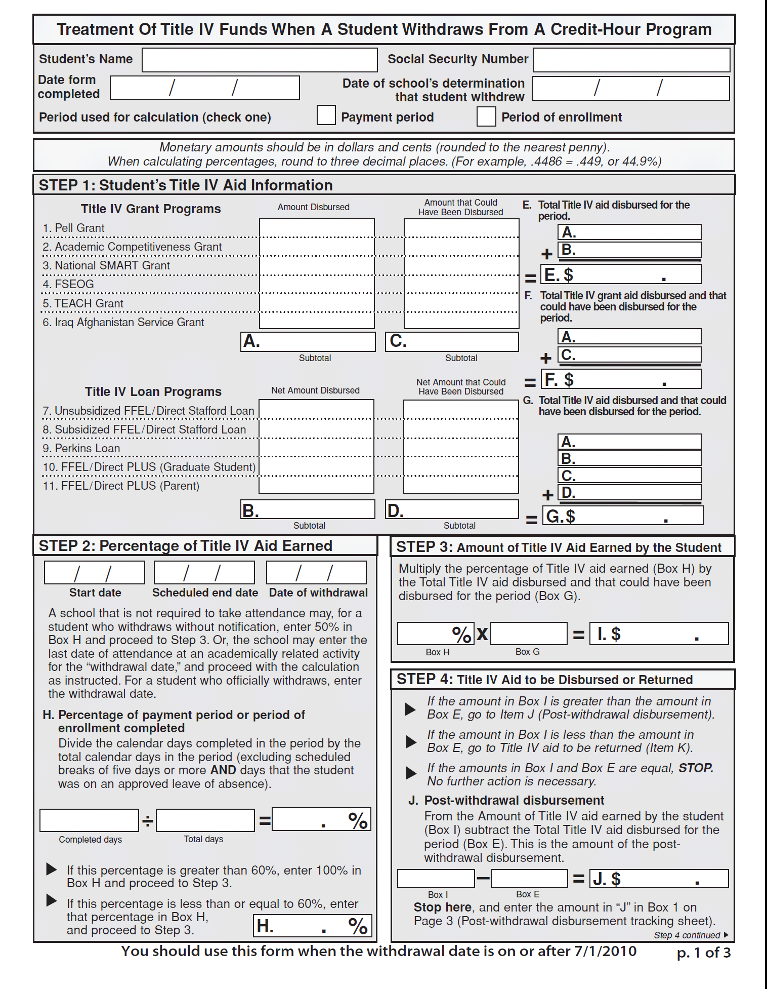
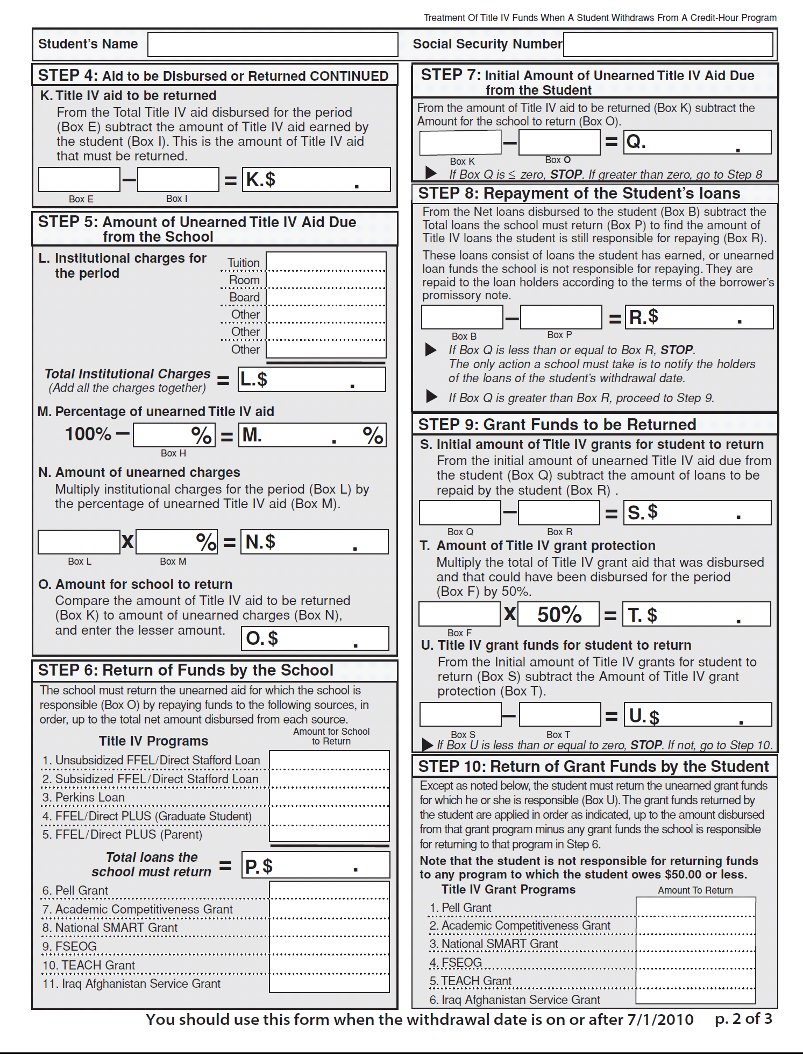
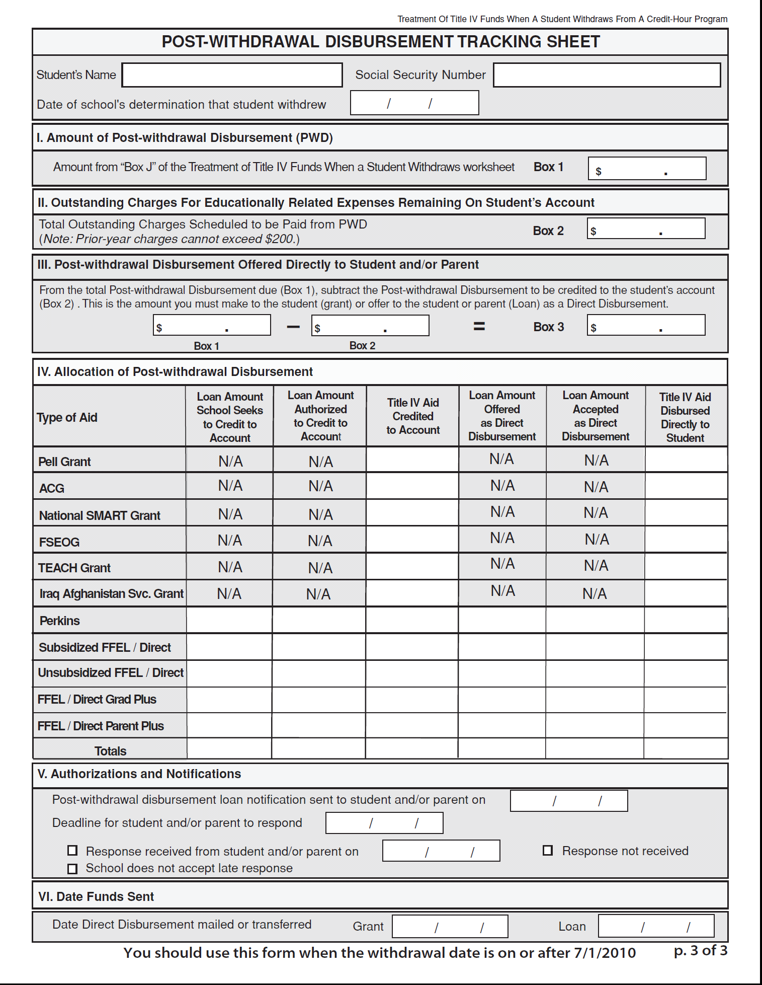
R2T4 Worksheets Review the Steps

Slide 5
“Date of school’s determination that student withdrew”
Trigger for deadlines
30 days for school to:
  Perform the R2T4 calculation
  Notify student of grant overpayment
  Notify student of eligibility for a post-withdrawal disbursement (PWD)
45 days for school to:
  Return Title IV funds to program
  Make post-withdrawal disbursement of Title IV grant funds
180 days to send Post Withdrawal Disbursement (PWD) to student or parent
Notes:
5

Slide 6
Withdrawal Date
School Required to Take Attendance
School is required to take attendance if
  Outside entity requires that attendance be taken OR
  School has own requirement that instructors take attendance OR
  Outside entity or school has requirement that can only be met by taking attendance or a comparable process

Slide 7
Withdrawal Date
School Required to Take Attendance
If required to take attendance—
  For some students—use attendance records for those students
  For a limited period of time—use attendance records for withdrawals during that limited period of time
  On a specific date—NOT considered to be required to take attendance

Slide 8
Withdrawal Date
School Not Required to Take Attendance
The earlier of the date the student began the school’s withdrawal process or the date the student otherwise provided “official” notice; or
If the student didn’t notify the school, it is the midpoint in period; or
If the student didn’t notify due to circumstances beyond the student’s control, it is the date related to that circumstance; or
Notes:
8

Slide 9

Withdrawal Date
School Not Required to Take Attendance
If student didn’t return from approved leave of absence, it is the date the leave began; or
If student took unapproved leave of absence, it is the date student began the leave; or
Date of student’s last attendance at documented academically-related activity
  School must document
    Event is academically related
    Student attended
Notes:
9

Slide 10
Program “Offered in Modules”
Module 1
Module 2
Module 3
Term has three modules. Each Module is 33 days, with a weekend between Modules 1 & 2 and 2 & 3. Total is103 days
Cheryl enrolls in all three modules, begins/completes Module 1. Does not return for Modules 2 & 3, provides no notice to school.
Institution Required to Take Attendance
  Withdrawal Date - documented last date of attendance, day 33
  33/ 103 = 32.0%
Institution not Required to Take Attendance
  Withdrawal Date is either the 50% point of the combined term or Cheryl’s last date of an academically-related activity.
  50%

Slide 11
Program “Offered in Modules”
Module 1
Module 2
Module 3
Term has three modules. Each Module is 33 days, with a week in between Modules 1 & 2 and 2 & 3. That is a total of 117 days.
Anthony enrolls in all three modules. Begins/completes Module 1. Does not return for Modules 2 & 3, does not contact school.
Institution Required to Take Attendance
  Withdrawal Date is documented last date of attendance.
  33 / 99 = 33.3%
Institution not Required to Take Attendance
  Withdrawal Date is the 50% point of the combined term or Anthony’s last date of an academically-related activity.
  50%

Slide 12
R2T4 – Definitions
Standard Terms
  Semesters, trimesters – generally 14–17 weeks long
  Quarters – generally 10–12 weeks long
Non-standard terms – where all coursework is expected to begin and end within a set period of time that is not a semester, trimester, or quarter terms
Non-terms – all credit hour programs that do not begin and end within a set time (self-paced), where courses overlap, where sequential courses do not begin, and end within a term

Slide 13
R2T4 – Definitions
Week of instructional time
  Any seven consecutive day period with at least one day in which scheduled instruction or examination occurs
  Does not include homework time, vacation time, orientation, or counseling

Slide 14

Programs & Courses Offered In Modules

Slide 15
Offered In Modules
New rules define a program “offered in modules”
  A course or courses in program do not span entire length of payment period or period of enrollment
Doesn’t matter what “modules” are called at the institution
15

Slide 16
Standard Term With Modules
Standard term program “offered in modules”
  Two 8-week sessions within a 16 week semester
  Three 5-week sessions within a 15 week semester
  Two 6-week sessions within a 12 week quarter
  Winter “inter-session” or “J term” between fall and spring semesters
16

Slide 17
When Is Student A Withdrawal?
  Student considered to be withdrawal if does not complete all days scheduled to complete within payment period/term
  School must document completed all courses with a passing grade
  If no passing grade in last scheduled course, school must demonstrate student completed period

Slide 18

Return After Withdrawal
Modular term-based credit hour program
  Withdrawn student may return to same program prior to end of payment period/period of enrollment

Slide 19
Written Confirmation Of Return
Student in modular program not considered a withdrawal if
  Provides written confirmation of intent
    Must be provided at the time of withdrawal
  Student may change return date in writing
    Must provide change prior to original return date

Slide 20

Written Confirmation Of Return
Nonstandard & Non-term Programs
  Student considered to be withdrawal if not scheduled to begin another course in period of enrollment for more than 45 calendar days
    45 days measured from end of module ceased attending

Slide 21
After Written Confirmation Of Return
Student considered to be withdrawal if does not return as scheduled
Withdrawal dates back to time that confirmation originally provided
  Determine withdrawal date and days of attendance as if confirmation of future attendance never provided

Slide 22
Calendar Days - Credit Hour Modules
Total calendar days include all days on which the student was scheduled to attend
  Days of completed courses count if course does not span length of term
  Exclude scheduled breaks of at least 5 consecutive days when student not scheduled to attend a module or other course offered during that period
For a withdrawn student who has made schedule changes
  Do not count days of withdrawn courses after official withdrawal prior to complete cessation of attendance
22

Slide 23

Examples:
R2T4
&
Modules

Slide 24
Summer Module Example
Fall and Spring = standard terms
    All courses last for full 15 weeks; not considered to be “offered in modules”
Summer = three 5-week sessions (combined to be a standard term offered in modules)
    Students can enroll in any one, two or all three summer sessions
    Students enrolled in the 5-week summer sessions are considered in programs “offered in modules” since none of the sessions span the entire length of the term (the 15-week period)

Slide 25
Summer Module Example
Session 1
5 weeks
Session 2
5 weeks
Session 3
5 weeks
33 days
2 days
33 days
2 days
33 days
Enrolls in all three summer sessions. Completes session 1, begins session 2, and stops attending on day 10. No withdrawal or confirmation to return.
R2T4 required.
Recalculate Pell before R2T4.
Withdrawal date is day 10 of session 2.
45 days/103 days = .4369 = 43.7%

Slide 26
Business Times University (BTU) Scenario
15-week Full Term 103 days
9/06 – 12/17
Part 1
33 days
Part 2
33 days
Part 3
33 days
2 days
2 days
9/06 –10/08
10/11 – 11/12
11/15 – 12/17
Standard Semester
Academic year is 30 weeks, 103 days
Also offers courses in 3 Parts of term,
Part of term is 5 weeks,33 days
.

Slide 27
BTU Example 1
Full Term = 9/06 – 12/17
9/06 begins attendance in 6 credits in Full Term
9/28 withdraws from 3 credits in Full Term
11/12 withdraws from 3 credits in Full Term
Part 1
9/06 –10/08
N/E
Part 2
10/11 – 11/12
3 credits
Part 3
11/15 – 12/17
3 credits
2 days
2 days
10/11 begins 3 credits in Part 2
11/12 completes 3 credits in Part 2
11/12 withdraws 3 credits in Part 3

Slide 28
BTU Example 1
Enrollment ends 11/12 with completed course and official withdrawal*
Was to attend until 12/17
R2T4 required
Withdrawal date is 11/12, 68 days
Enrollment period is 09/06 – 12/17, 103 days
68/103 = .6602 = 66.0%
*complete and withdraw same day = withdrawal

Slide 29
BTU Example 2
Full Term = 9/06 – 12/17
9/06 begins attendance in 6 credits in Full Term
9/22 withdraws 3 credits in Full Term
12/17 completes 3 credits in Full Term
Part 1
9/06 –10/08 3 credits
Part 2
10/11 – 11/12
N/E
Part 3
11/15 – 12/17
3 credits
2 days
2 days
09/06 begins attendance in 3 credits in Part 1
10/08 completes 3 credits in Part 1
11/15 begins 3 credits in Part 3
12/07 withdraws from 3 credits in Part 3

Slide 30
BTU Example 2
Enrollment ends 12/17 with completed course
No R2T4 required

Slide 31
BTU Example 3
Full Term = 9/06 – 12/17
9/06 begins attendance in 6 credits in Full Term
9/14 withdraws 6 credits in Full Term
Part 1
9/06 –10/08
3 credits
Part 2
10/11 – 11/12
N/E
Part 3
11/15 – 12/17
N/E
2 days
2 days
09/06 begins attendance in 3 credits in Part 1
9/24 withdraws 3 credits in Part 1

Slide 32
BTU Example 3
Enrollment ends 09/24 with official withdrawal
Was to attend until 10/08
R2T4 required
Withdrawal date is 09/24, 19 days
Enrollment period is 09/06 –10/08, 33 days
19/33 = .5757 = 57.6%

Slide 33
BTU Example 4
Full Term = 9/06 – 12/17
Not enrolled in any Full Term courses
Part 1
9/06 –10/08
6 credits
Part 2
10/11 – 11/12
6 credits
Part 3
11/15 – 12/17
N/E
2 days
2 days
Greg withdraws on 10/01
Dave withdraws on 10/11
9/06 begin attendance in 6 credits in Part 1

Slide 34
BTU Example 4
Dave
Enrollment ends 10/11 with official withdrawal
Was to attend until 11/12
R2T4 required
Withdrawal date is 10/11, 36 days
Enrollment period is 9/06 – 11/12, 68 days
36/68 = .5294 = 52.9%

Slide 35
Non-Term Credit In Modules
Mod 1
33 days
Mod 2
33 days
Mod 3
33 days
Mod 4
33 days
Mod 5
33 days
Mod 6
33 days
09/06 -10/08
10/11 -11/12
11/15 – 12/17
01/03 – 02/04
02/07 – 03/11
03/14 – 04/15
Academic year is 30 weeks, 206 days
Enrollment is for full academic year

Slide 36
Non-Term Credit in Modules
9/06 begins attendance
11/04 withdraws Mod 2 and Mod 3
11/04 confirms return Mod 4 on 01/03
Out of school more than 45 days
R2T4 required
Withdrawal date is 11/04, 60 days
Enrollment period is full academic year, 206 days
60/206 = .291 = 29.1%

Slide 37
Non-Term Credit In Modules
Mod 1
33 days
Mod 2
33 days
Mod 3
33 days
Mod 4
33 days
Mod 5
33 days
Mod 6
33 days
09/06 -10/08
10/11 -11/12
11/15 – 12/17
01/03 – 02/04
02/07 – 03/11
03/14 – 04/15
Academic year is 30 weeks, 206 days
Enrollment is for full academic year
.

Slide 38
Non-Term Credit in Modules
9/06 begins attendance
10/29 withdraws Mod 2
10/29 confirms return Mod 3 on 11/15
Returns and completes Mod 3
01/12 withdraws 4
No confirmation of return
R2T4 required
Withdrawal date is 01/12
  54 days 9/06 -10/29
  43 days 11/15 - 01/12
Enrollment period is full academic year, 206 days
97/206 = .4709 = 47.1%

Slide 39
Is Student A Withdrawal?
Did the student cease to attend before completing or fail to begin attendance in a course scheduled to attend?
  If yes, go to question 2.
  If no, student not a withdrawal
When ceased to attend or failed to begin attendance in a scheduled course, was the student attending other courses?
  If yes, student not a withdrawal
  If no, go to question 3
Did the student confirm attendance in a later module in the payment/enrollment period (45 day rule, if applicable)?
  If no, student is a withdrawal.
  If not a withdrawal, Pell recalculations may apply
39
39

Slide 40

Resources
&
References

Slide 41
Additional Resources
Dear Colleague Letter GEN-11-14 (July, 2011)
Dear Colleague Letter GEN-04-03 (November 2004)
Dear Colleague Letter GEN-00-24 (December 2000)
R2T4 Demo Site - http://fafsademo.test.ed.gov
R2T4 website available through FAA Access to CPS Online
  http://www.faaaccess.ed.gov/
FSA Handbook, Volume 5, Chapter 2
34 C.F.R 668.22; Federal Register – October 29, 2010
FSA Assessments
  http://www.ifap.ed.gov/qahome/qaassessments/returntivfunds.html

Slide 42

Thank you
for joining us
today!

