Slide 1
Federal Update
October 31, 2012
Jeff Baker
Federal Student Aid
U.S. Department of Education

Slide 2
Topics
College Choice Tools
studentaid.gov
Default Rates
Regulatory Activity
Recent Statutory Changes
  Elimination of ATB
  Pell Duration of Eligibility
  Grace Period Subsidy
  Subsidized Loan Limitation
Verification

Slide 3
College Choice Tools
3

Slide 4
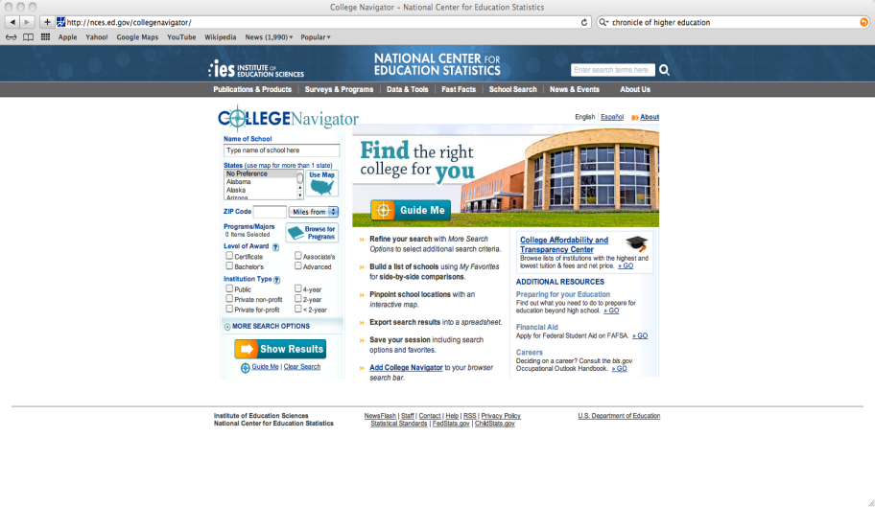
College Navigator Tool

Slide 5
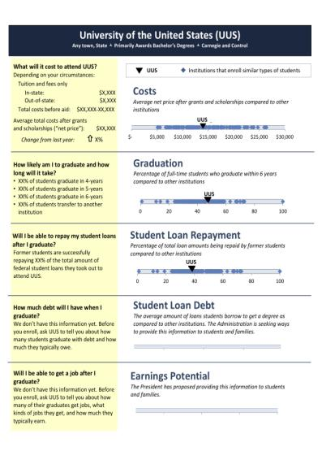
College Choice: ScoreCard

Slide 6
Financial Aid Shopping Sheet
Student Specific Information:
Institutional Metrics:
Graduation rate under “Student Right-to-Know”
Most recent cohort default rate
Median debt for completers
Loan repayment information
Cost of Attendance Elements
Grant s and Scholarships
Net price After Grants
Work Options
Loan Options
Other Options Including Family Contribution
Contact information
Custom Message

Slide 7
studentaid.gov
7

Slide 8
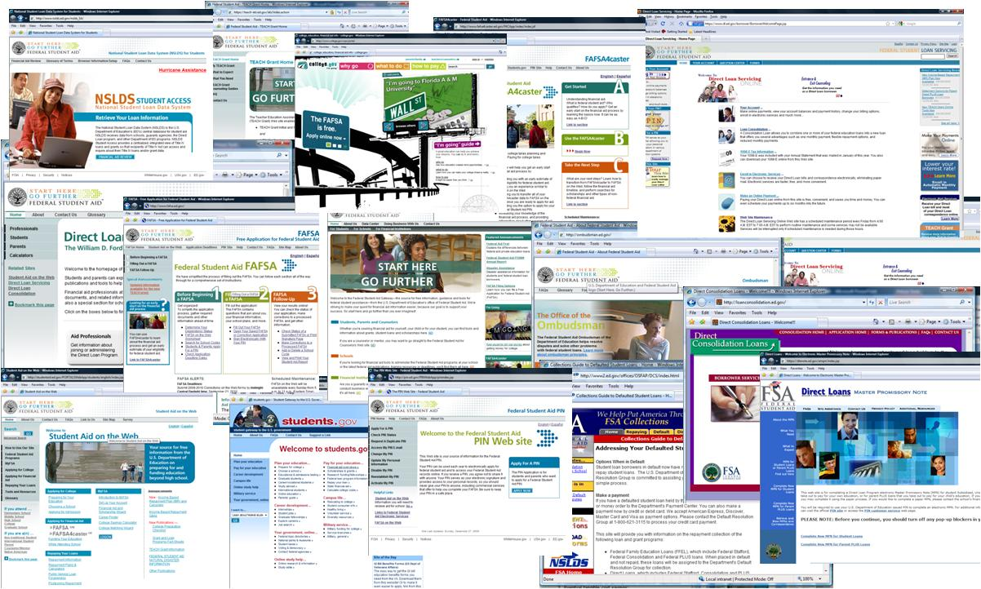
Federal Student Aid Websites

Slide 9
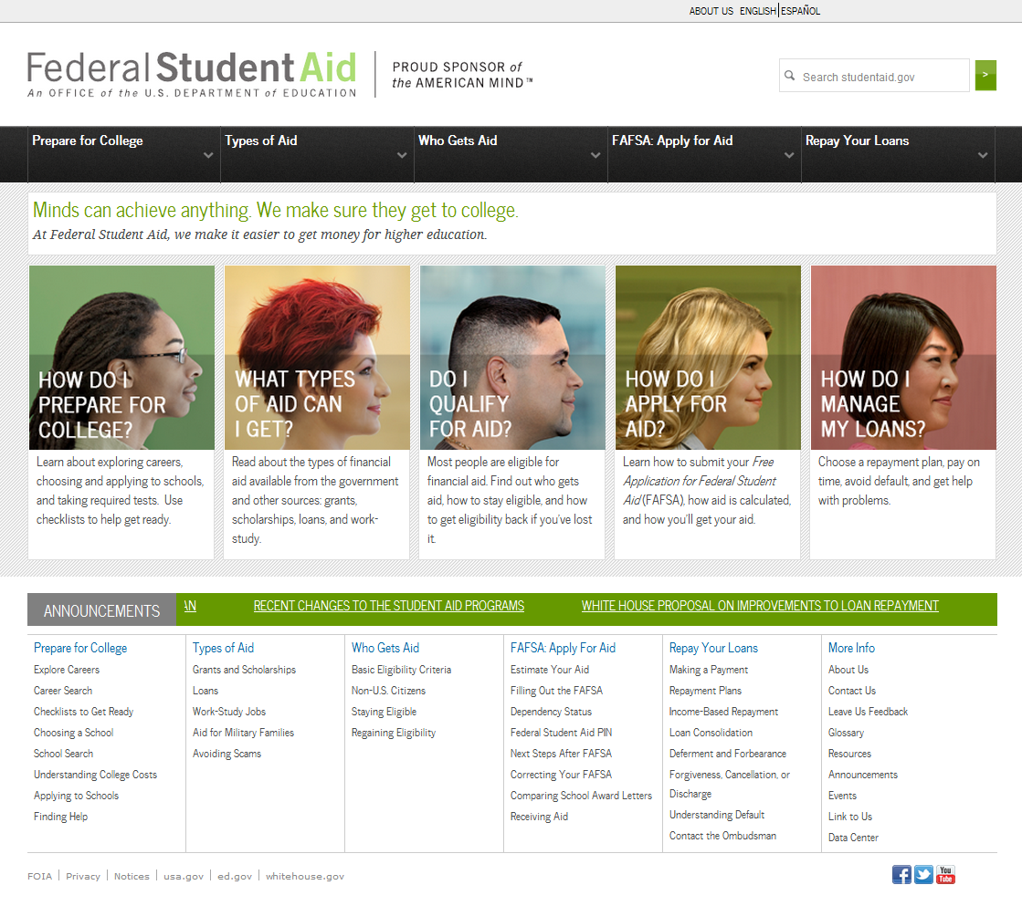
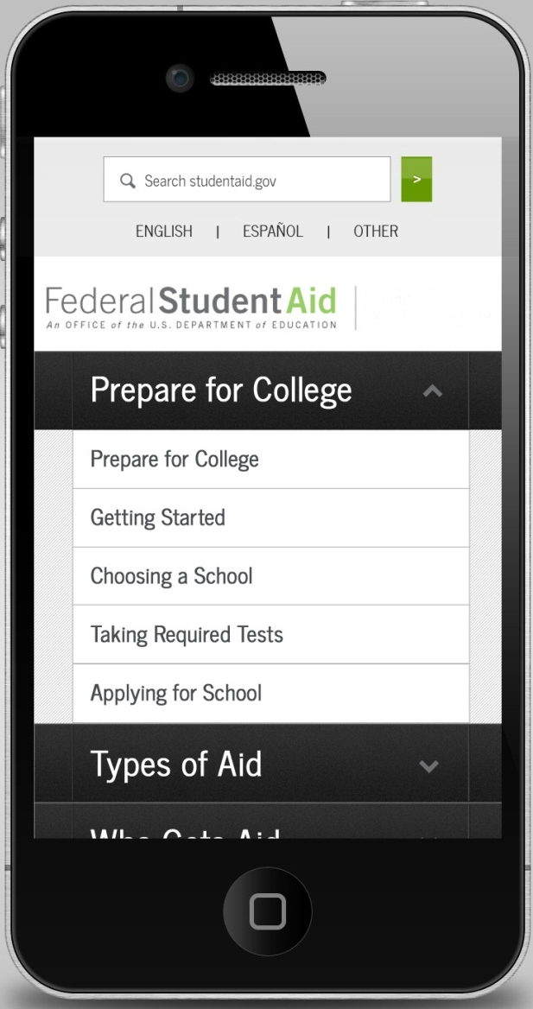
Solution: StudentAid.gov
Notes:
Comprehensive information on federal student aid – from awareness, to application, to repayment. Includes repayment calculators, videos, and images/infographics.
Approach and design based on focus groups and online surveys.
Serves audiences from middle school students and parents to adults, applicants, and borrowers.
Available in English and Spanish
FSA’s first mobile-optimized site to display on all devices include tablets and smart phones.
Links to FSA’s other key sites
Continuous enhancements and improvements including customer usability testing

Slide 10
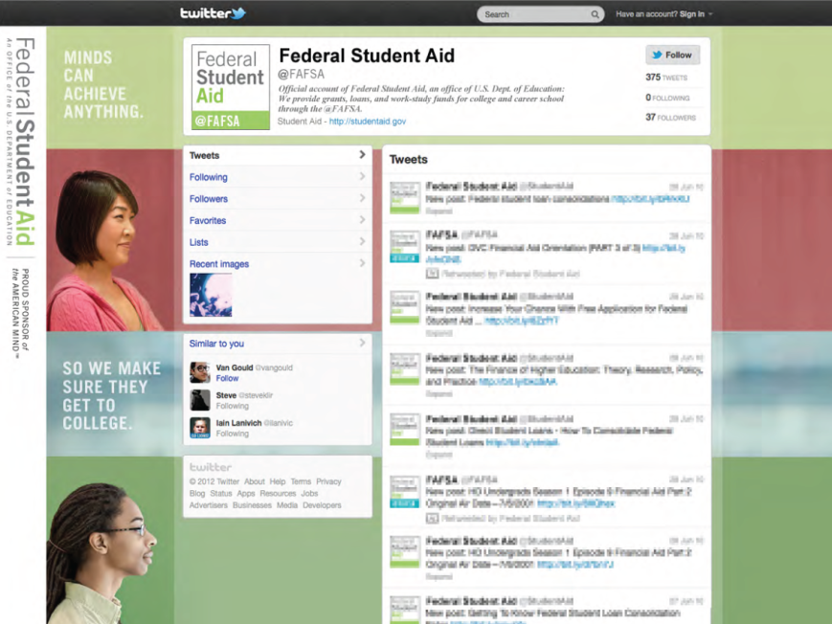
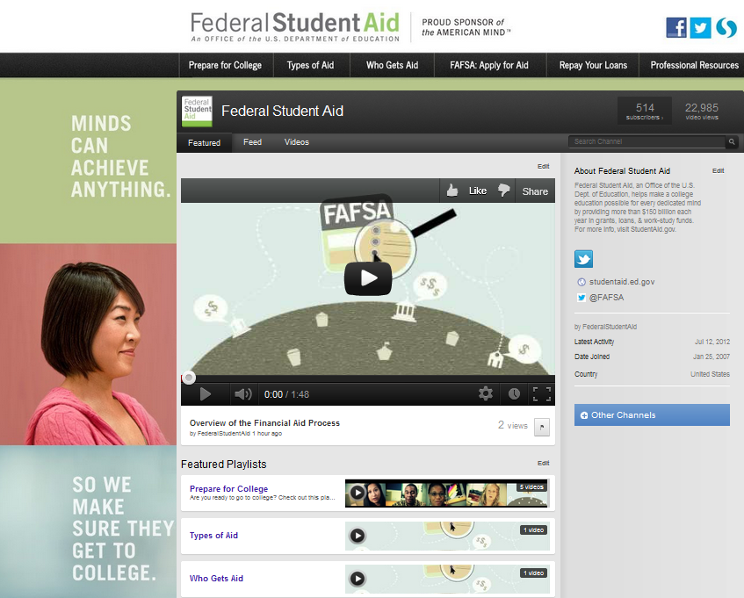

FSA Social Media
Twitter
YouTube
Facebook
Notes:
FSA is also launching updated social media sites on Facebook, YouTube and Twitter
Our social media sites are integrated with the StudentAid.gov website
We post regular updates on our Twitter and Facebook sites
@FAFSA on Twitter was originally released in January to assist students and families with information on completing the FAFSA
We hold monthly @FAFSA Office Hours on Twitter featuring various financial aid topics and guests
We hope you’ll follow us, share it with your students and join in the conversation

Slide 11
FFEL/Direct Loan
Cohort Default Rates

Slide 12
What is the CDR Calculation?
A cohort default rate is the percentage of the number of the school’s FFEL and Direct Loan borrowers who enter repayment in one Federal Fiscal Year (October 1 through September 30) who default in that federal fiscal year or by the end of the next federal fiscal year.

Slide 13
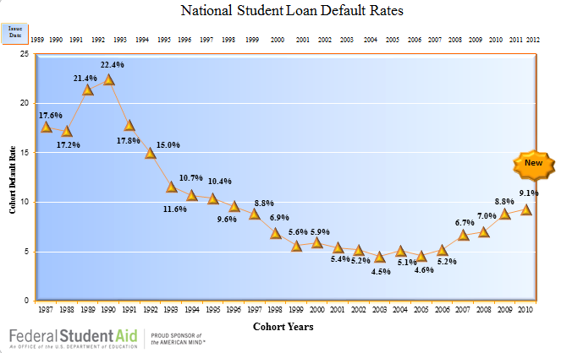

Slide 14
HEOA Changes
Increases the CDR monitoring period from two to three years.
Beginning with the 2009 cohort, the calculation will be:
  Borrowers who default in that federal fiscal year or by the end of the next two federal fiscal years.
  FY 2009 3-year rate is 13.4%
  Establishes a three-year transition period for sanctions.

Slide 15
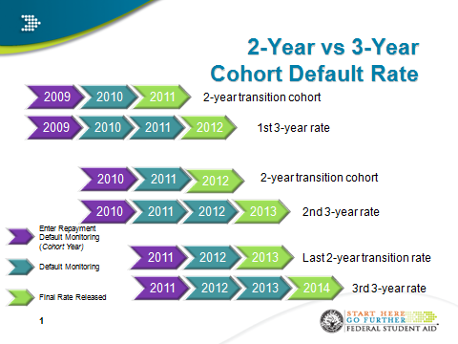
Transition Period

Slide 16
Regulatory Activity
16

Slide 17
Regulatory Activity
  Loans I
    Pay as You Earn
    Total and permanent disability
  Loans II
    Stand alone Direct Loan regulations
    FFEL origination elimination
    Reasonable and affordable payments for defaulted loan rehabilitation
17

Slide 18
Regulatory Activity
  Teacher Preparation
    TEACH Grant
    Title II accountability and reporting systems
  Pell Grant
    Finalization of Summer Cross-Over Interim Rule
  Fraud Prevention
    New Neg Reg Process
    Early in 2013
18

Slide 19
Pay As You Earn
  Income Based Repayment (IBR) Plan
    Statutory - FFEL and Direct Loan
    Maximum annual payment amount is 15% of discretionary income.
    Remaining balance forgiven after 25 years.
  New Law (SAFRA) – Effective 2014
    Maximum annual payment amount is 10% of discretionary income
    Remaining balance forgiven after 20 years.
    New Borrowers on or after July 1, 2014
19

Slide 20
Pay As You Earn
  Income Contingent Repayment (ICR) Plan
    Statutory - Direct Loan Only
      Regulatory defined formula
        Complex
        Loan amount and income
        Remaining balance forgiven after 25 years.
        Limited “take-up” rate
20

Slide 21
  Pay As You Earn Plan Repayment Plan
  Amend ICR regulations to –
    Reduce maximum annual payment about from 15% of discretionary income to 10%
    Reduce forgiveness time from 25 years to 20 years
    Available to more borrowers
  Negotiated rulemaking concluded in March, 2012
    NPRM Published July 17, 2012
    Expected final rule publication date on Nov 1.
    Possible Early Implementation
Pay As You Earn
21

Slide 22
Recent Statutory Changes
22

Slide 23
Ability-to-Benefit (ATB)
Eliminates Title IV eligibility for students without a high school diploma (or equivalent).
  Exception for
    Home schooled students
    Students who are or were, enrolled in a Title IV eligible program anytime prior to July 1, 2012, may continue to qualify under one of the ATB alternatives
      Approved ATB test
      Completion of six credit or 225 clock hours
23

Slide 24
Pell Duration of Eligibility
Establishes the duration of a student’s eligibility to receive Pell Grant to 12 semesters (or its equivalent).
Applies to all students effective with the 2012-13 award year.
Calculation includes all earlier years of the student’s receipt of Pell/Basic Grant
  Back to 1974.
24

Slide 25
Pell Duration of Eligibility
Scheduled Award –
  Based on the statutory maximum award amount for the year and the student’s EFC (and COA)
  Amount student would be eligible for if enrolled fulltime for a full academic year
  2013-2014 – Maximum Award is $5,550
    If EFC = 0, scheduled award is $5,550
    If EFC = 1,000, scheduled award is $4,550
Annual Award –
  Amount of scheduled award received by the student
    Less than fulltime
    Less than a full academic year
25

Slide 26
Pell Grant Duration of Eligibility
  Example –
    Student’s Scheduled Award was $5,550, but only received $2,775 because only enrolled for one semester, will have used 50% of that award year’s scheduled award.
    Student who was enrolled three-quarter time for the entire award year would have used 75% of his scheduled award.

Slide 27
Pell Duration of Eligibility
Calculate the equivalency by adding together each of the annual percentages of a student’s scheduled award that was actually disbursed to the student.
  LEU – Lifetime Eligibility Used
    The example student’s LEU is 125% of the total 600%.
  Once LEU reaches 600%, student no longer eligible.
  If LEU more than 500% but less than 600%, partial eligibility for next award year.
27

Slide 28
Grace Period Interest Subsidy
  Temporarily eliminates the interest subsidy on Direct Subsidized Loans during the six month grace period.
    Applies to new Direct Stafford Loans for which the first disbursement is made on or after July 1, 2012, and before July 1, 2014.
28

Slide 29
Subsidized Loan Limitation
When a student has received subsidized loans for 150% of the published time of the academic program –
  The student may not receive any additional subsidized loans, and
  The subsidized loans received from July 1, 2013 on lose their subsidy
Applies to “new borrowers” on or after July 1, 2013.
Special calculation of 150% for transfer students
Special calculation for less than fulltime students

Slide 30
Subsidized Loan Limitation
First instance could be as early as December 2013 because of short-term programs.
FSA will track, calculate, and inform.
  Likely to be codes and comments on ISIRs
  COD Editing
Schools will need to provide program information, including length of program
  Probably as part of COD reporting

Slide 31
Verification
31

Slide 32
2012-13 Verification Items
    Still some tax filers not able to obtain IRS Tax Return Transcripts
      Additional guidance forthcoming
32

Slide 33
2013-14 Verification Items
    Annual Federal Register notice—
      Items to verify
      Acceptable documentation
    2013-2014 Federal Register Notice: July 12, 2012
    DCL GEN-12-11, July 17, 2012
33

Slide 34
2013-14 Verification Items
Same core FAFSA items as in 2012-2013
  AGI
  Taxes Paid
  Four Untaxed Income Items
  Education Credits
  Number in Household
  Number in College
  SNAP
  Child Support paid
34

Slide 35
2013-14 Verification Items
Two new verification items to combat fraud
  High School Completion Status
  Identify/Statement of Educational Purpose
  Guidance on acceptable documentation forthcoming
35

Slide 36
2013-14 Verification
Five Verification Tracking Groups
  V1 - Standard Verification Group
    Same core FAFSA items as in 2012-2013
  V2 - SNAP Verification Group
    SNAP Only
  V3 - Child Support Paid Verification Group
    Child Support Paid Only
36

Slide 37
2013-14 Verification
Five Verification Tracking Groups
  V4 - Custom Verification Group
    High School Completion
    Identity/Statement of Educational Purpose
  V5 - Aggregate Verification Group
    All items from Groups V1 and V4
37

Slide 38


QUESTIONS?

